Slide 1






CAREERS, NOT COURSES
AT NEWBURY COLLEGE
newbury college
Notes:
Hello, I’m ____________ and I’m here to tell you about Newbury College.

Slide 2

WHY NEWBURY COLLEGE?
PROGRESSION
FOCUSED
Subjects based on your chosen career
Career-focused objectives
newbury college
CAREERS, NOT COURSES

Slide 3

WHY NEWBURY COLLEGE?
EMPLOYER-LED
Curriculum influenced by businesses
Industry placements with excellent employers
newbury college
CAREERS, NOT COURSES

Slide 4

WHY NEWBURY COLLEGE?
SKILLS-BASED
Practical subjects
Fewer exams
Different assessment methods
newbury college
CAREERS, NOT COURSES

Slide 5
DON’T I NEED TO STAY AT SCHOOL?
Notes:
Do you need to stay at school? The short answer is NO. Legally you need to stay in some form of education or training until you’re 18, but this can be sixth form, college or an apprenticeship.

Slide 6
PATHWAYS
ACADEMIC
A Levels
University
VOCATIONAL
Career
BTECs/NVQs
/T Levels
HNC/HND
or University
Apprenticeships
Higher Apprenticeships
newbury college
CAREERS, NOT COURSES
Notes:
There is nothing wrong with sixth form at all, and for some jobs taking A Levels and going to university is the best route into that profession, however, vocational programmes like BTECs, T Levels and Apprenticeships also offer progression to university and have the added benefits of the technical experience that supports your employability.

Slide 7


PROGRAMMES
VOCATIONAL
Different assessment methods
Fewer exams
Skills based
Specific practical skills and knowledge in a chosen industry or occupation
45 days of industry placement at a relevant employer
Core English, maths & digital skills
1 T Level = to 3 A levels
Earn while you learn
Hands-on training
Study up to degree level
newbury college
CAREERS, NOT COURSES
Notes:
We have many different ways to study At Newbury College. Our courses are skills based with lots of practical lessons. We have fewer exams and are often practical assessments rather than written exams.
-Hands up if you have heard of T Levels
T Levels are a lot newer than other qualifications . We have offered them for approx 3 years now and are adding more subjects each year. T Levels are a great way to study and gain relevant hands on experience in your chosen industry giving you a head start on your CV when it comes to applying for work after college.
You may be familiar with the word apprenticeships. An apprenticeship is an employed job with an element of training . Generally speaking you would spend 80% of your time in your job as an apprentice and 20% at college studying. You can find a list on our website for current vacancies.

Slide 8

WHERE TO START
Entry Req.*
Min. five GCSEs at grade 4 or above, including maths and English.
Entry Req.*
Min. five GCSEs at grade 3 or above, including maths and English.
Entry Req.*
Min. two GCSEs at grade 2 or above.
Level 3
Level 2
Equivalent to A Levels, these qualifications offer a focussed route to higher education or meaningful employment.
Level 1
Designed to give students a good grounding to progress onto level 3 or entry level employment.
Introductory level qualifications for students building up to a level 2 programme.
newbury college
CAREERS, NOT COURSES

Slide 9


PROGRESSION
Achieve your degree locally
Smaller classes
Debt-free options
Supported by university partners
Notes:
University Centre Newbury is part of the Newbury College family and offers HNCs, HNDs and degree-level programmes from our Monks Lane campus. The qualifications are awarded by our awarding body and university partners, but studied locally. Class sizes tend to be smaller than traditional universities and if you are fortunate enough to study your programme as part of an apprenticeship, your employer pays your fees. Even if you are paying for your own education, the cost of studying at UCN can be significantly lower than going to university and you are still entitled to take out a student loan.

Slide 10
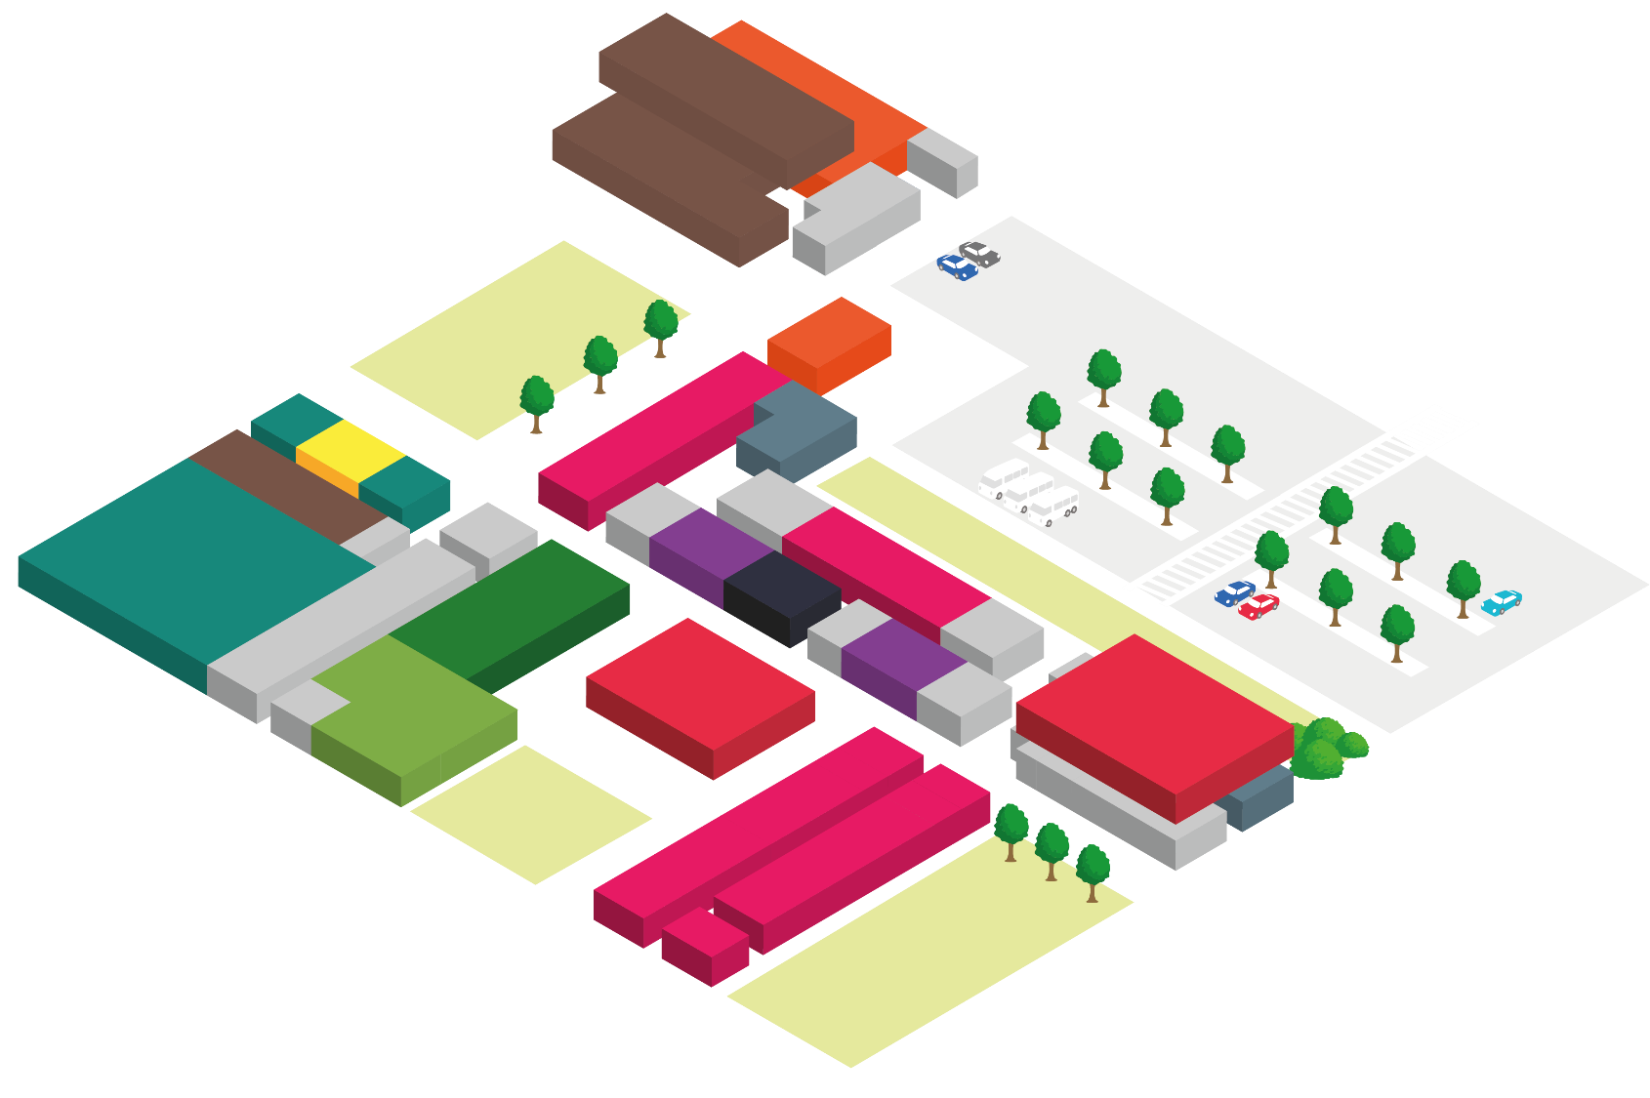
RENEWABLES CENTRE AND CONSTRUCTION WORKSHOPS
FACILITIES
ART STUDIOS
SPORTS HALL AND GYM
SALONS
ENGINEERING WORKSHOPS
SOCIAL AREAS
KITCHEN AND RESTAURANT
newbury college
CAREERS, NOT COURSES
Notes:
The reason we are able to offer such great career-focused programmes is down to our fantastic facilities. Many of them have been designed to reflect the industries you’re looking to work in, such as out engineering workshops, art studios and our new renewables centre.

Slide 11
HOW DO I APPLY?
Notes:
It’s easy to apply, even if you’re not 100% sure yet.

Slide 12

Home > Courses > Protective Services, Forensics, Sport and Fitness > Uniformed Public Services Level 3
UNIFORMED PUBLIC SERVICES LEVEL 3
Description +
Entry Requirements +
Qualification +
Progression +
Assessment +
Home Study +
Work Placement +
Apply Now
The Extended Diploma is the equivalent of three A Levels. This course is for anyone who is interested in seeking employment within the public services such as: Armed forces, Royal Marines, Royal Navy, Air force, Army, Military Police, Emergency Services Fire Service, Police, Prison Service and Security
Notes:
Visit our website and look for the subject you want to study. They click “Apply Now” and fill out the short form. We will then be in touch to arrange a discussion with you and take it from there.

Slide 13
ANY QUESTIONS?
newbury college
Notes:
Any questions?

