Slide 1
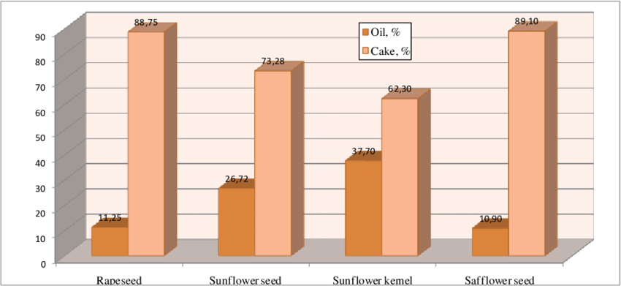
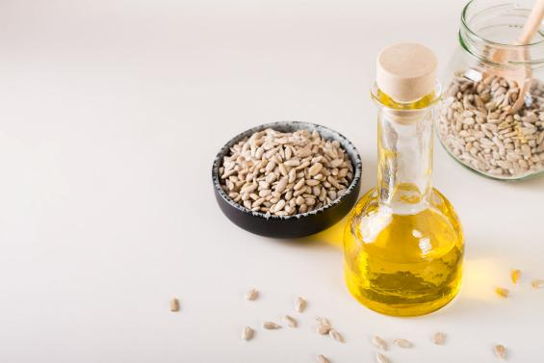

Oleaginous Biomass Conversion
The quantitative interrelationship between the Oil Yield and the resultant Press Cake Percentage—often termed the Defatted Solid Residue Mass Fraction—constitutes a foundational metric in the techno-economic evaluation of oleaginous seed processing, reflective of the intrinsic lipid content and the efficacy of the employed oleo-extraction methodology. The theoretical limit is dictated by the seed's gravimetric oil content, while the empirical reality is modulated by cellular disruption, thermal conditioning, and residual oil post-extraction.
Seeds type | Oil (%) | Cake (%)
Rapeseed | 11.25 | 88.75
Sunflower seed | 26.72 | 73.28
Sunflower kernel | 37.7 | 62.3
Safflower seed | 10.9 | 89.1
Notes:
Chart = Oil yield variation depending on the oleaginous seeds type, at 2 mm/min piston speed and 100 kN applied force

